Slide 1
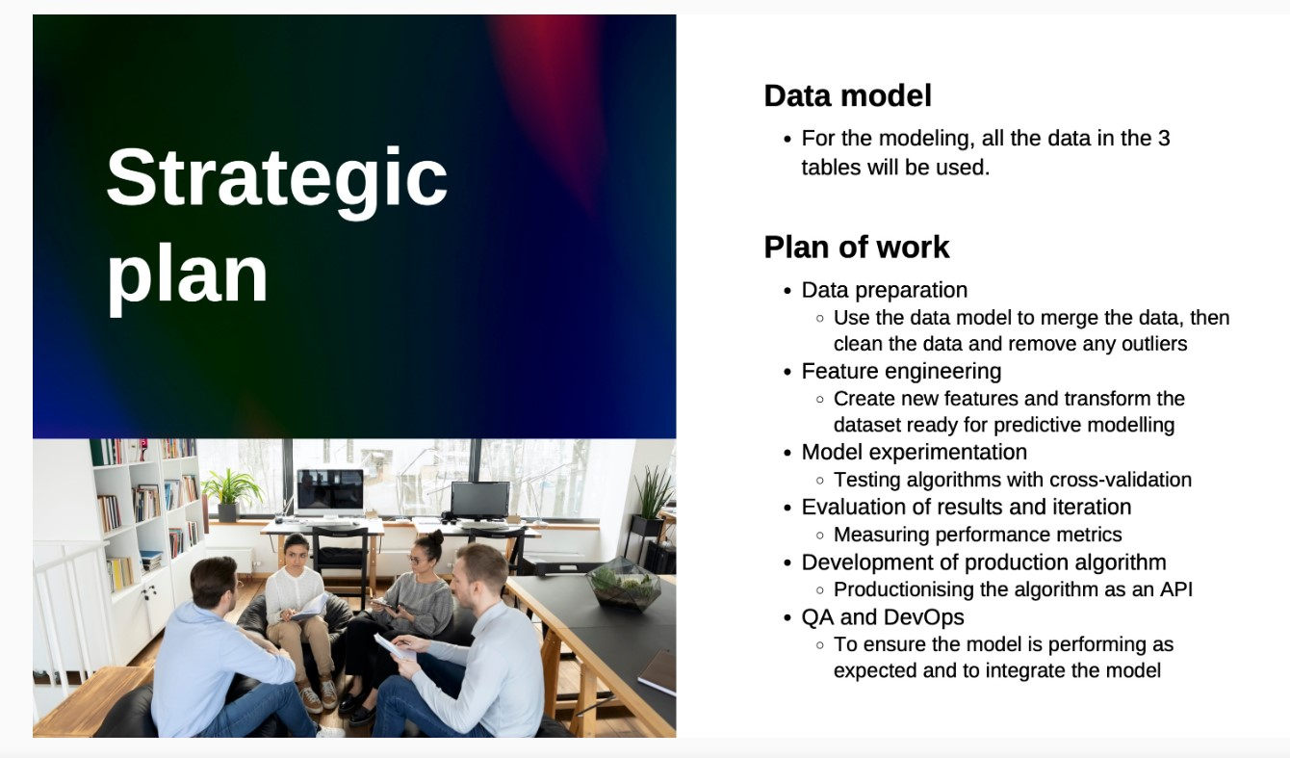

Slide 2
Strategic Planning
Here, we will use the Product ID and category to find that which product is sold the most.
Then, we will make a new column using hour and category and then find which product is sold the most and in which period of time.
We will also use the payment_type to see which payment feature should never be effected.
In addition to this, we will also use the quantity and product ID column to find which category of most is sold the most.
Data Collection
Data Preprocessing
Exploratory Data Analysis
Model Building
Model Evaluation

